Slide 1
Cloud Computing
Dr. Emmanuel S. Pilli
MNIT Jaipur

Slide 2
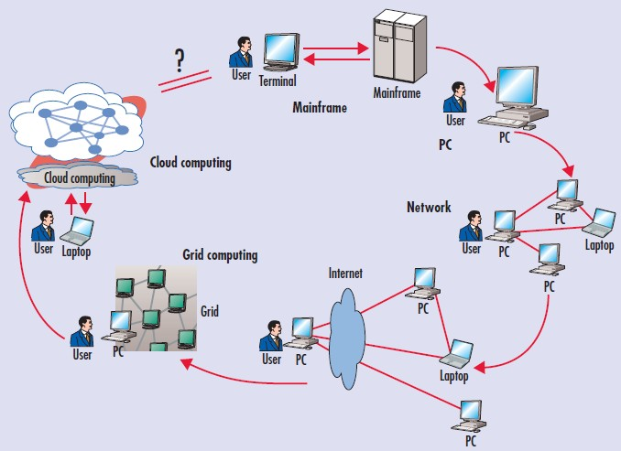
Evolution

Slide 3




Processor Speed

Slide 4





Alternatives
Workstation
PC
Mini Computer
Mainframe
Vector Supercomputer
MPP

Slide 5
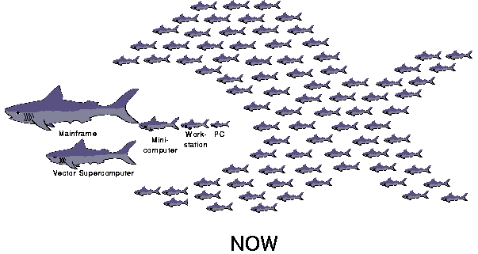
Network of Workstations

Slide 6
Cluster
A Cluster is a type of parallel or distributed processing system
which consists of a collection of interconnected stand alone / complete computers
cooperatively working together as a single integrated computing resource

Slide 7
Grid
A computational grid is a hardware and software infrastructure that provides dependable, consistent, pervasive, and inexpensive access to high-end computational capabilities (Foster & Kesselman, 1998).
Resource sharing & coordinated problem solving in dynamic, multi-institutional virtual organizations

Slide 8
Grid Vs Cluster Computing
When two or more computers are used together to solve a problem, it is called a computer Cluster
Cluster is
homogenous
Cluster computers have the same hardware & OS
Grid computing makes use of several computers connected to solve a large problem
Grids are heterogeneous
Grid computers can run different OSs and can have different hardware

Slide 9
Multi-Core Processors
Multi-core processor architecture entails placing of two or more execution cores within a single processor chip.
This multi-core processor plugs directly into a single processor socket
Operating system perceives each of its execution cores as a discrete logical processor with all the associated execution resources.

Slide 10
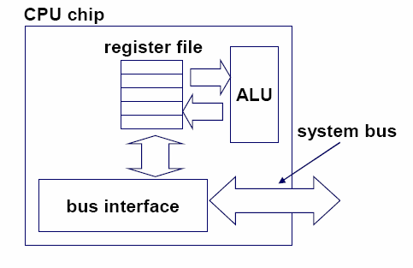
Single-core CPU chip
the single core

Slide 11
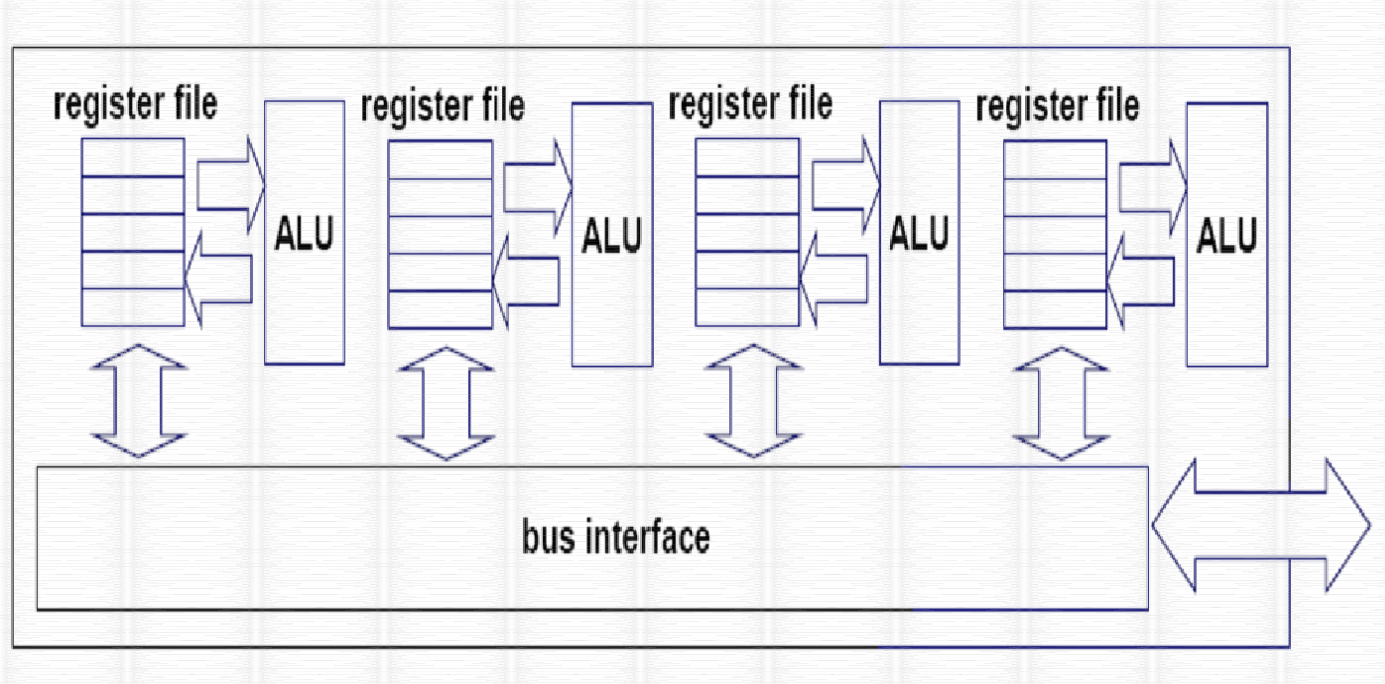
Multi-core CPU chip
Core 1
Core 2
Core 3
Core 4

Slide 12
Why Multi-Core
The doubling of transistors every couple of years has been maintained for forty years
If this rate continued, processors would soon be producing more heat per square centimeter than the surface of the sun—setting hard limits to frequency increases.
There are 16, 32, 64, and so on, up to perhaps 256 processor cores on a single die.

Slide 13
Concurrent & Parallel Programming
Challenge of “Thinking Parallel”
Number of Cores in a Processor are increasing
Programming in parallel is not intrinsically harder than what we do now but it is different. We need to think differently and we need tools which support this thinking

Slide 14
Concurrent versus Parallel
Concurrency is when two tasks can start, run, and complete in overlapping time periods.
Parallelism is when tasks literally run at the same time, eg. on a multicore processor.
Parallelism: A condition that arises when at least two threads are executing simultaneously.
Concurrency: A condition that exists when at least two threads are making progress.

Slide 15
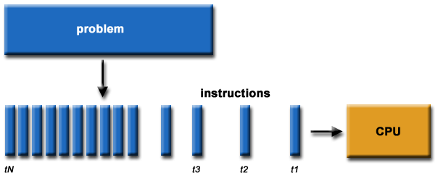
Concurrent versus Parallel

Slide 16
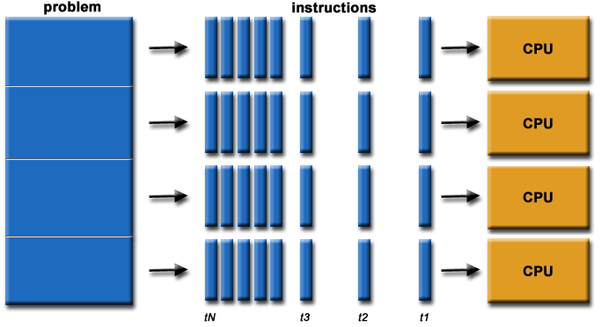
Concurrent versus Parallel

Slide 17
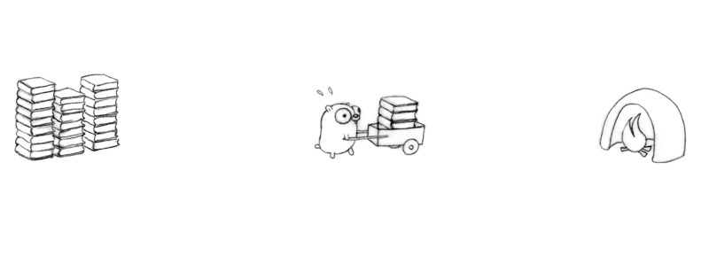
Problem !

Slide 18
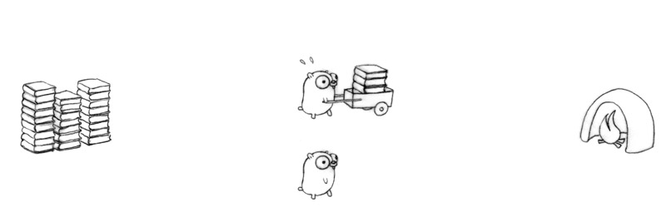
Solution ?

Slide 19
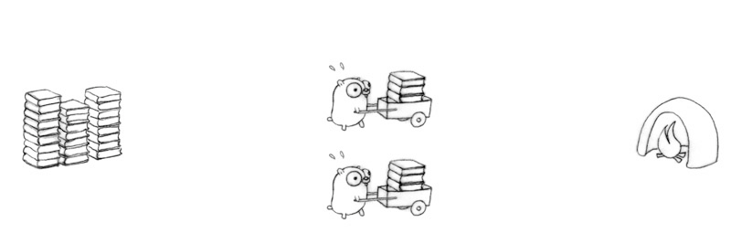
Parallel ?

Slide 20
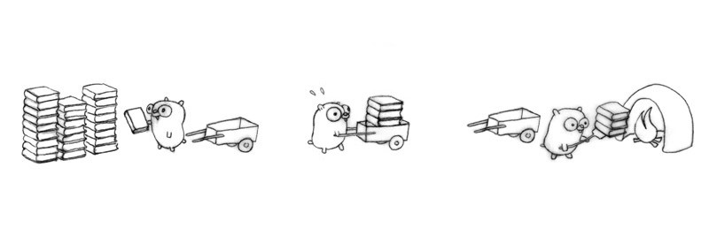
Concurrent ?

Slide 21
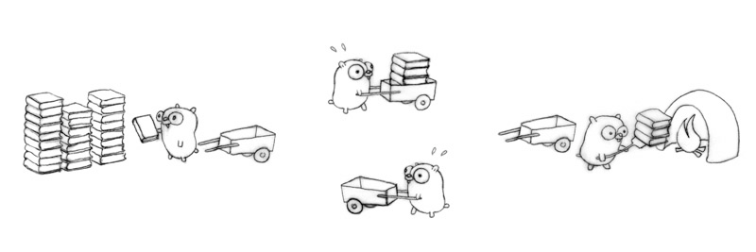
More Concurrent ?

Slide 22
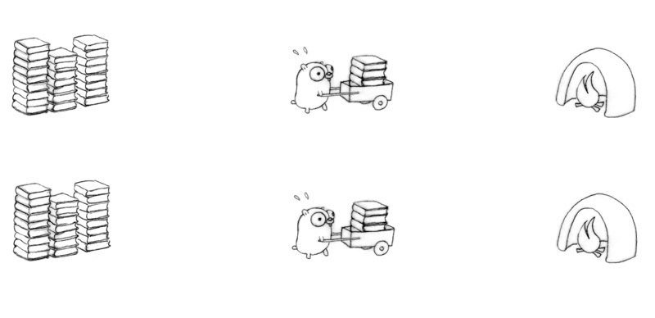
Parallel ?

Slide 23
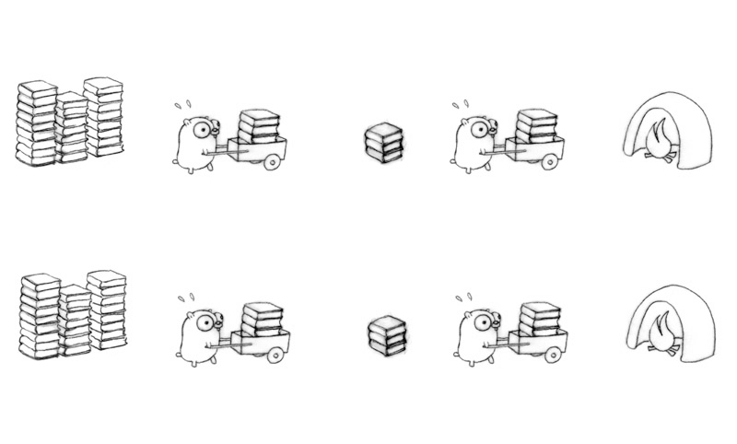
Concurrent or Parallel ?

Slide 24
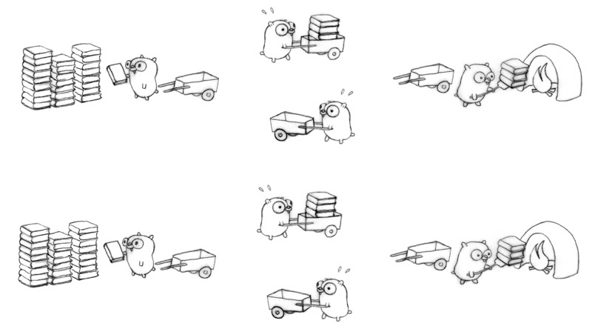
Concurrent or Parallel ?

Slide 25
Foundations
Technologies | Description
Grid Computing | Form of distributed computing which applies the resources of numerous computers in a network to work on a single complex task at the same time
Utility Computing | Service provisioning model that offers computing resources as a metered service
Virtualization | Provides improved utilization of resources Enables optimization of resources by over subscription
Service Oriented Architecture (SOA) | An architectural approach in which applications make use of services available in the network Each service provides a specific function

Slide 26






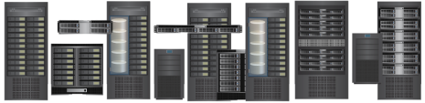
Cloud Infrastructure
Cloud Infrastructure Management and Service Creation Tools
Applications and Platform Software
Virtual
Infrastructure
Physical
Infrastructure

Slide 27
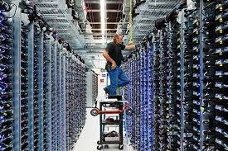
Data Center

Slide 28
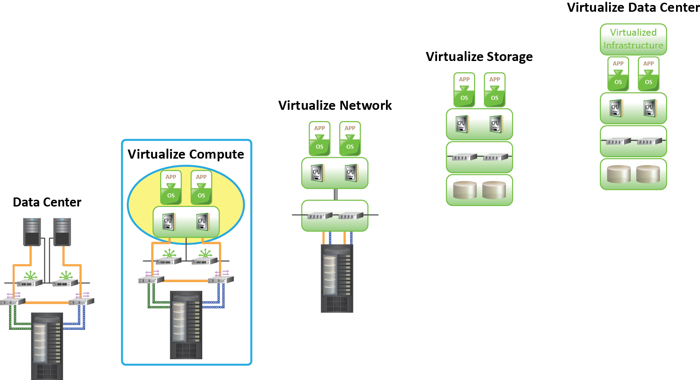
Classic Data Center
Core elements of classic data center are:
Compute
Storage
Network
Operating System
DBMS
Application
Classic Data Center

Slide 29
Virtualized Data Center
Virtualization may be implemented at compute, storage, network, and/or application layers
Virtualization Benefits:
Optimizes utilization of IT infrastructure
Reduces cost and management complexity
Reduces deployment time
Increases flexibility

Slide 30

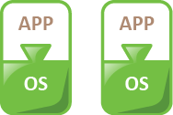


Virtualized Data Center
Classic Data Center
Virtualized Data Center
Virtualized
Infrastructure

Slide 31
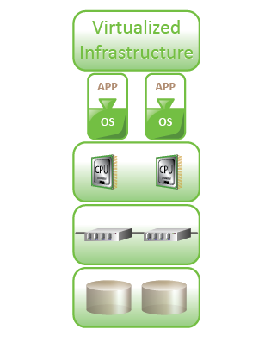
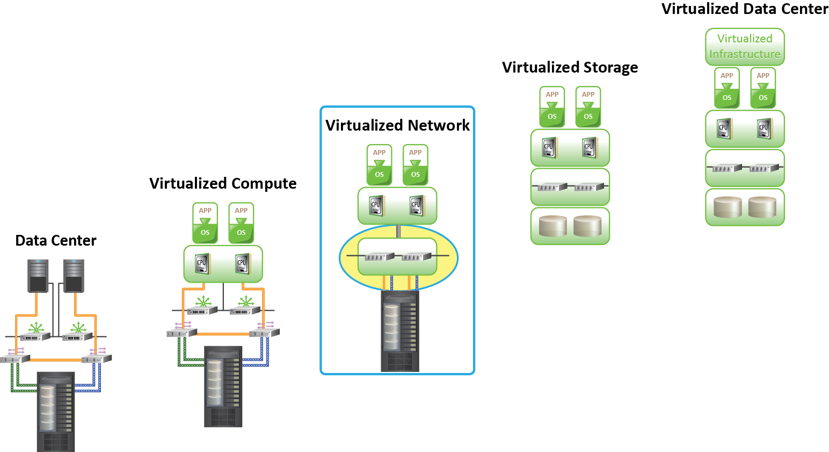
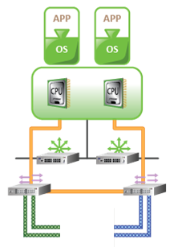
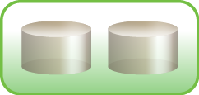
Virtualized Data Center
Transforming a Classic Data Center (CDC) into a Virtualized Data Center (VDC) requires virtualizing the core elements of the data center.
Virtualized Data Center (VDC)
Virtualize Network
Virtualize Storage
Virtualize Compute
Classic Data Center (CDC)
Using a phased approach to a virtualized infrastructure enables smoother transition to virtualize core elements.
Notes:
Virtualization is the first step towards building a cloud infrastructure. Transforming a Classic Data Center (CDC) into a Virtualized Data Center (VDC) requires virtualizing the core elements of the data center. A phased approach to virtualize an infrastructure enables a smooth transition from Classic Data Center to Virtualized Data Center .

Slide 32


Journey to the Cloud
Cloud
Cloud Services
Virtualized Data Center
Virtualized
Infrastructure
Classic Data Center
Virtualized
Infrastructure

Slide 33
Cloud Computing
“Computing may someday be organized as a public utility, just as the electricity is organized as a public utility”
– John McCarthy, speech at MIT in 1961

Slide 34
Definition (NIST)
A model for
enabling ubiquitous, convenient, on-demand
network access to a shared pool
of configurable computing resources (e.g., servers, storage, networks, applications, and services)
that can be rapidly provisioned and released
with minimal management effort or service provider interaction

Slide 35
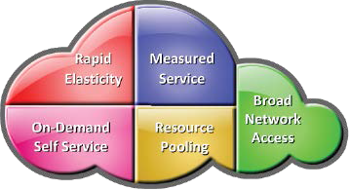
Essential Characteristics
47

Slide 36
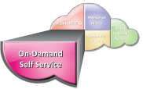
On-Demand Self-Service
Enables consumers to get computing resources as and when required, without any human intervention
Facilitates consumer to leverage “ready to use” services or, enables to choose required services from the service catalog
Allows provisioning of resources using self-service interface
Self-service interface should be user-friendly
Notes:
The on-demand and self-service aspects of Cloud Computing mean that a consumer can use Cloud services as required, without any human intervention with the Cloud service provider. By using the self service interface, consumers can adopt Cloud services by requesting for the necessary IT resources from the service catalog. In order to be effective and acceptable to the consumer, the self-service interface must be user-friendly.

Slide 37

Broad Network Access
Cloud services are accessed via the network, usually the internet, from a broad range of client platforms such as:
Desktop computer
Laptop
Mobile phone
Thin Client
Eliminates the need for accessing a particular client platform to access the services
Enables accessing the services from anywhere across the globe

Slide 38
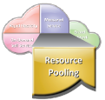
Resource Pooling
IT resources (compute, storage, network) are pooled to serve multiple consumers
Based on multi-tenant model
Consumer has no knowledge about the exact location of the resources provided
Resources are dynamically assigned and reassigned based on the consumer demand

Slide 39
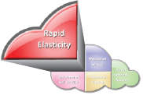
Rapid Elasticity
Ability to scale IT resources rapidly, as required, to fulfill the changing needs without interruption of service
Resources can be both scaled up and scaled down dynamically
To the consumer, the Cloud appears to be infinite
Consumers can start with minimal computing power and can expand their environment to any size

Slide 40
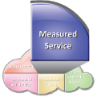
Metered Service
Consumers are billed based on the metered usage of Cloud resources
Cost incurred on a pay-per-use basis
Pricing/billing model is tied up with the required service levels
Resource usage is monitored and reported
Provides transparency for chargeback to both
Cloud service provider
Consumer about the utilized service

Slide 41
Cloud Service Models
Cloud Service can be classified into three categories:
 Infrastructure-as-a-Service (IaaS)
 Platform-as-a-Service (PaaS)
 Software-as-a-Service (SaaS)

Slide 42


Infrastructure-as-a-Service
Provides capability to the consumer to hire infrastructure components such as servers, storage, and network
Enables consumers to deploy and run software, including OS and applications
Pays for infrastructure components usage, for example, Storage capacity, CPU usage, etc.
Application
Databases
OS
Compute
Storage
Network

Slide 43
Platform-as-a-Service
Capability provided to the consumer to deploy consumer-created or acquired applications on the Cloud provider’s infrastructure
Consumer has control over
Deployed applications
Possible application hosting environment configurations
Consumer is billed for platform software components
OS, Database, Middleware
Application
Databases
OS
Compute
Storage
Network

Slide 44
Software-as-a-Service
Capability provided to the consumer to use provider’s applications running in a Cloud infrastructure
Complete stack including application is provided as a service
Application is accessible from various client devices, for example, via a thin client interface such as a Web browser
Billing is based on the application usage
Consumer
Application
Databases
OS
Compute
Storage
Hired Resources
Network

Slide 45
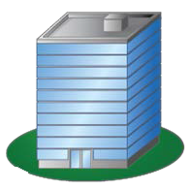

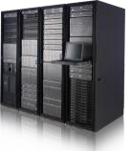

Deployment – Public Cloud
Enterprise P
Enterprise Q
Public Cloud
Cloud Service Provider
User R

Slide 46

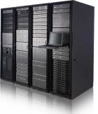
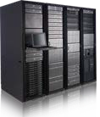
Deployment – Private Cloud
On-premise Private Cloud
Externally hosted Private Cloud
Enterprise P
Enterprise P
Dedicated for Enterprise P
Cloud
Service Provider

Slide 47
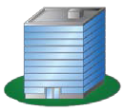



Deployment – Hybrid Cloud
Private Cloud
Public Cloud
Enterprise P
Enterprise P
Enterprise Q
+
Cloud Service Provider
User R

Slide 48
Deployment – Community Cloud
Enterprise P
Enterprise Q
Community Cloud
Enterprise R
Dedicated for Community Users
Cloud Service Provider
Community Users
 Cloud infrastructure is shared by several organizations and supports a specific community that has shared concerns
 Managed by the organizations or by a third party

Slide 49



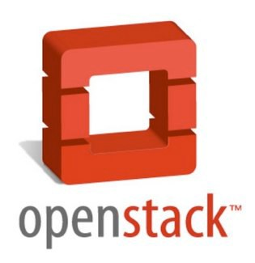




Tools
Hypervisors:
Hybrid Cloud Software:

Slide 50
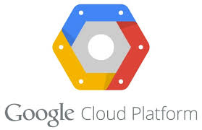

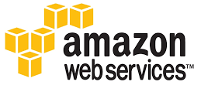



Public CSPs
Google Cloud Platform
https://cloud.google.com
Microsoft Azure
http://azure.microsoft.com
Amazon EC2
http://aws.amazon.com/ec2
IBM BlueMix
http://www.ibm.com/cloud-computing/bluemix
Salesforce
http://www.salesforce.com
Rackspace
http://www.rackspace.com

Slide 51
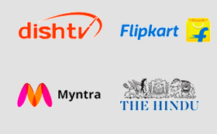

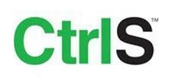
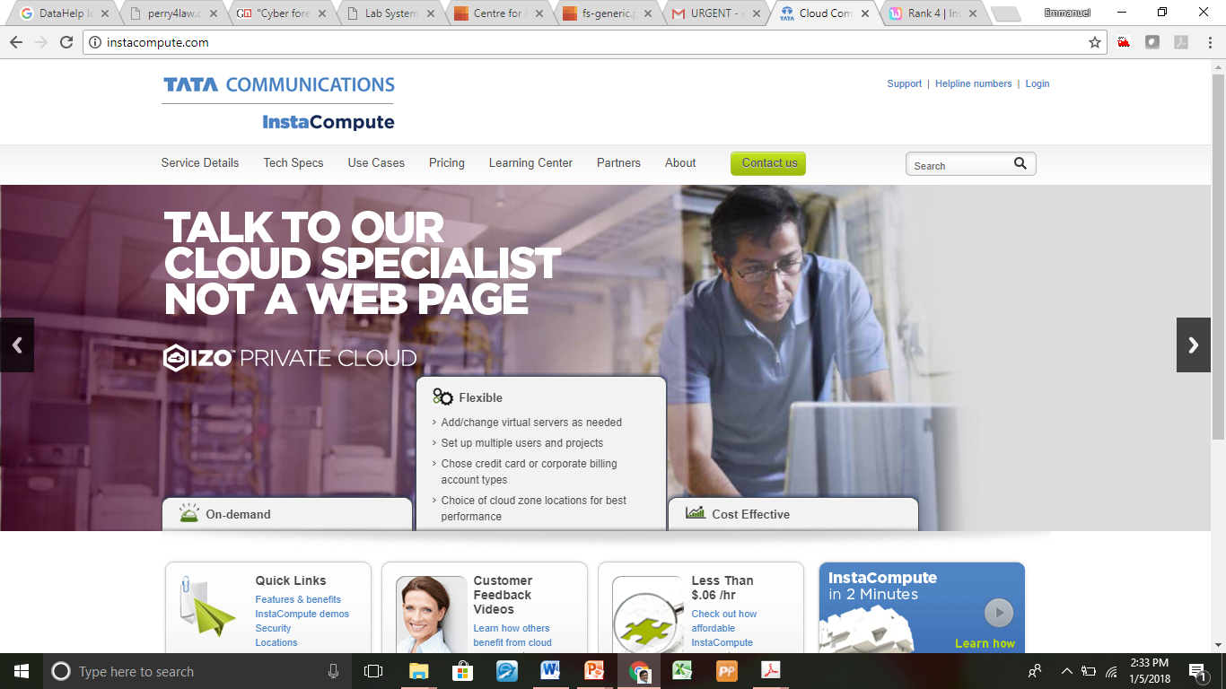
Cloud Service Providers – India
Netmagic
https://www.netmagicsolutions.com
CtrlS
http://www.ctrls.in/
InstaCompute
http://www.instacompute.com/

Slide 52
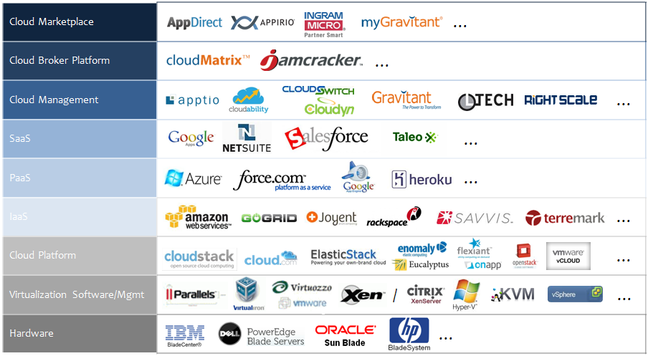
Cloud Service Providers

